Slide 1
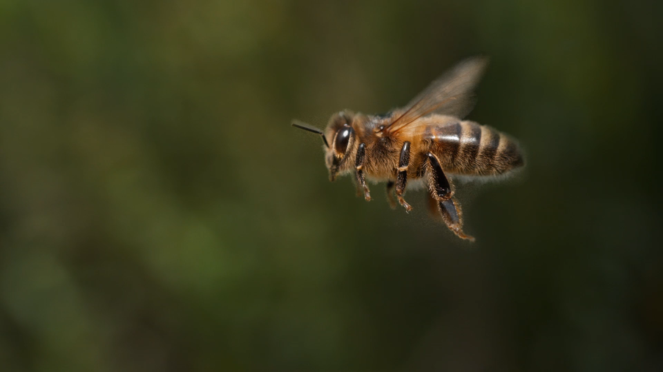
Sustainable Habitats: Combating Human Induced Decline
Cerys| Laura | Luke

Slide 2

Design Challenge
decline in sustainable habitats for bees due to urban development.
no action being taken to recuperate the habitats there is a decline in various natural phenomena.
We want to impose a prototype that raises awareness of the situation
This can be accomplished with different Technological methods

Slide 3

Current Situation
Urbanisation is destroying habitats
Deforestation is forcing bees to relocate
Not enough greenery in urban areas for bees to be sustained

Slide 4

Audience
Impact
Young adults
Kids
Environmental Charities
Education
Future in Sustainability
Awareness of Pollution

Slide 5
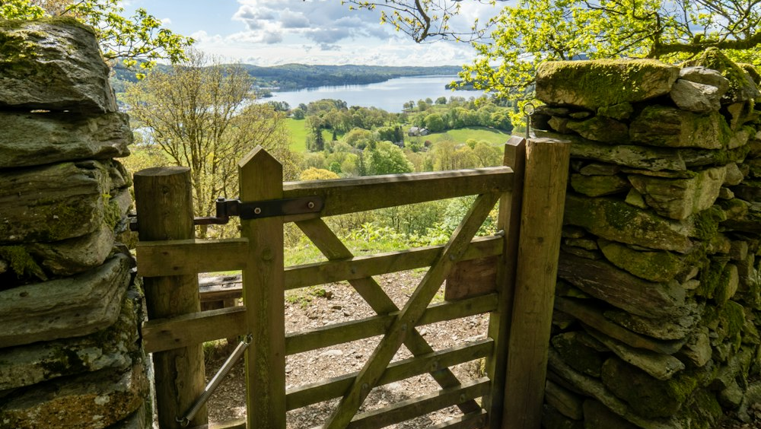
Constraints
c
How to spread awareness to a demographic that doesn’t perhaps want to listen.
How can you fully engage people.
How to make a niche topic more of a forefront issue.

Slide 6

Prototype Form
Unity
Maya
Physical Models
Videos
Graphics
MAX msp

Slide 7

Prototype Schedule
c
Week 1 – Think of problems
Week 2 – Design Personas and User Needs
Week 3 – Create design brief
Week 4 – Research into interactions and problem
Week 5 – TBD

